Slide 1
TRAFFIC MANAGEMENT USING IOT
TEAM LEADER : PRASANNA.M.L (822721106033)
IOT_Phase1 : Document submission
PROBLEM TITLE : Traffic management system

Slide 2
Introduction
Project Definition
Design Thinking
Project Objectives
IoT Sensor Design
Real-Time Transit Information Platform

Slide 3
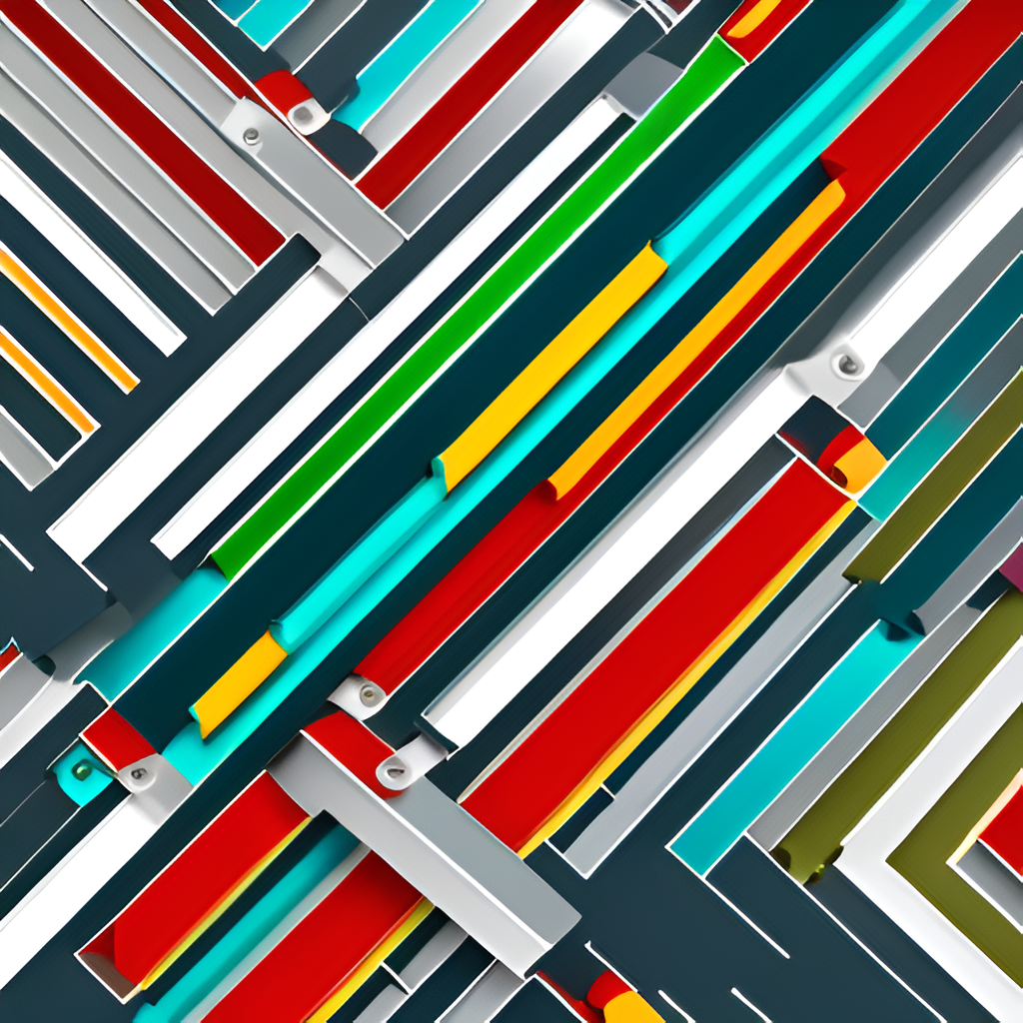
Introduction
Welcome to our presentation on the innovative use of IoT devices and data analytics to monitor traffic flow and congestion in real-time. Our project aims to address the increasing problem of traffic congestion in urban areas by leveraging cutting-edge technology.
By using IoT sensors to collect real-time data on traffic patterns and applying advanced data analytics techniques, we can provide commuters with up-to-date information on traffic conditions. This will enable them to make informed decisions about their travel routes and ultimately reduce congestion on the roads.

Slide 4

Project Definition
The project aims to use IoT devices and data analytics to monitor traffic flow and congestion in real-time. To achieve this, the project has been divided into different components that include defining objectives, designing the IoT traffic monitoring system, developing the traffic information platform, and integrating them using IoT technology and Python.
In defining objectives, the team identified key goals such as real-time traffic monitoring, congestion detection, route optimization, and improved commuting experience. The next step was designing the IoT sensor network that will be deployed to monitor traffic flow and congestion. The sensors will collect data on traffic volume, speed, and other relevant parameters. Finally, the traffic information platform will be developed to display this data in real-time to the public through web-based platforms and mobile apps.

Slide 5

Project Objectives
Real-time traffic monitoring: The project aims to monitor traffic flow and congestion in real-time using IoT devices and data analytics. This will enable authorities to identify and respond to traffic issues quickly, reducing congestion and improving commuting times.
Congestion detection: By analyzing traffic patterns and identifying congestion hotspots, the project aims to reduce congestion and improve traffic flow on roads. This will lead to a more efficient transportation system and improved commuting experience for the public.
Route optimization: Through real-time traffic monitoring and congestion detection, the project aims to optimize routes for drivers and public transit systems. This will reduce travel time and improve overall transportation efficiency.
Improved commuting experience: By reducing congestion and optimizing routes, the project aims to provide a better commuting experience for the public. This includes reducing travel time, improving safety, and making transportation more accessible and convenient.

Slide 6
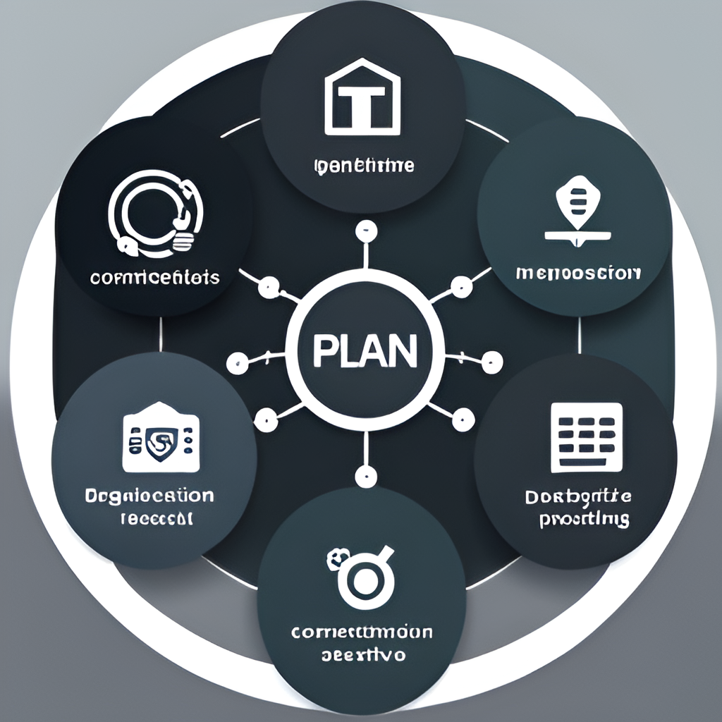
Design Thinking
The design thinking process for this project involved a comprehensive approach to problem-solving. The first step was to define the project objectives, which included real-time traffic monitoring, congestion detection, route optimization, and improved commuting experience. Once the objectives were defined, the team began planning the IoT sensor design. This involved determining the best locations for sensors to be deployed to monitor traffic flow and congestion. The team also had to consider the type of sensors that would be used and how they would be integrated into the overall system.
The next step in the design thinking process was to plan the real-time transit information platform. The team designed a web-based platform and mobile apps that would display real-time traffic information to the public. This involved creating a user-friendly interface that would allow users to easily access the information they needed. Finally, the team developed an integration approach that would bring all the components together using IoT technology and Python. This involved developing protocols for data transfer and analysis, as well as creating algorithms for route optimization.

Slide 7

IoT Sensor Design
The IoT sensor design is a crucial component of our project as it enables us to collect real-time data on traffic flow and congestion. The sensors will be deployed at strategic locations such as major intersections and highways to capture data on vehicle speed, volume, and density. The sensors will use a combination of technologies such as radar, cameras, and infrared to capture accurate data in all weather conditions.
To ensure optimal coverage, we have developed a deployment plan that takes into account factors such as road layout, traffic patterns, and potential obstacles. The sensors will be mounted on poles or other structures at a height that provides a clear view of the road. The data collected by the sensors will be transmitted wirelessly to our central database where it will be analyzed in real-time to provide insights into traffic flow and congestion.

Slide 8

Real-Time Transit Information Platform
The real-time transit information platform is a web-based application and mobile app that provides commuters with up-to-date information on traffic flow and congestion in their area. The platform is designed to be user-friendly and intuitive, with a clean and modern interface that allows users to quickly access the information they need.
The platform uses data collected from IoT sensors deployed throughout the city to provide real-time updates on traffic conditions. Commuters can use the platform to view current traffic flow, congestion levels, and estimated travel times for different routes. The platform also includes features such as route optimization, which suggests alternative routes based on traffic conditions, and alerts for accidents or road closures.

